Slide 1
Machine Learning on Equities
Trevor Tocchet, Enis Aras, Pavankumar RamadassVenkatesulu

Slide 2
Agenda
Introduction
Reinforcement Learning and Financial Data
Technical Details and Implementation
Results and Analysis
Next Steps
Questions
Notes:
Trevor
Introduction (our goal and our problem)

Slide 3
Introduction

Slide 4
Goal
Find a profitable trading strategy for various equity data using Reinforcement Learning.
Notes:
Trevor
The problem we are trying to solve is when to buy, sell, or hold a single stock
we were not worried about asset selection or asset allocation which are separate problems
We prioritized risk mitigation – meaning we didn’t care a whole lot about returns more just we didn't want to lose money

Slide 5
State of AI/ML/Algorithms and Finance
ETFs like BUZZ use artificial intelligence to gauge social sentiment analysis
Most intelligent portfolios like Wealthfront do not use much AI/ML
They mostly use algorithms in regards to MPT (modern portfolio theory) and use passive strategies
Quantitative hedge funds like Two Sigma leverage AI/ML for analysis
Notes:
There really aren’t that many full autonomous stock trading systems currently

Slide 6
Reinforcement Learning and Financial Data
Notes:
Enis

Slide 7
Financial Data
Stock data is time series data
Making decisions when trading could require more data
Immense amount of data to take into consideration when making decisions
Technical vs Fundamental Trading
Political Events
Sentiment Analysis
State of the Economy
Insider Trading

Slide 8
Why Reinforcement Learning?
Agent interacts with their environment through actions in order to maximize reward
Environment -> Stock market
Agents -> Investors
Actions -> Buy, Sell, and Hold
Notes:
Enis
We will get more into the details later

Slide 9
Exploratory Data Analysis on Equity Data
Price
Volume
Performance Analysis against the S&P 500
Daily Returns
Sharpe Ratio
Notes:
Enis

Slide 10
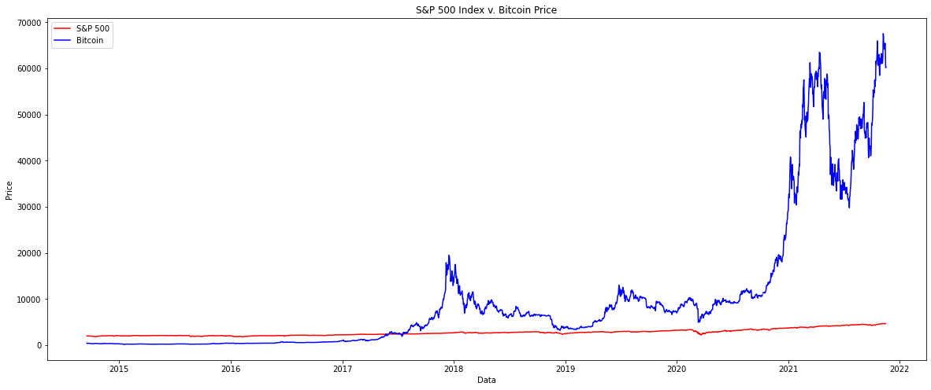
Notes:
Enis

Slide 11
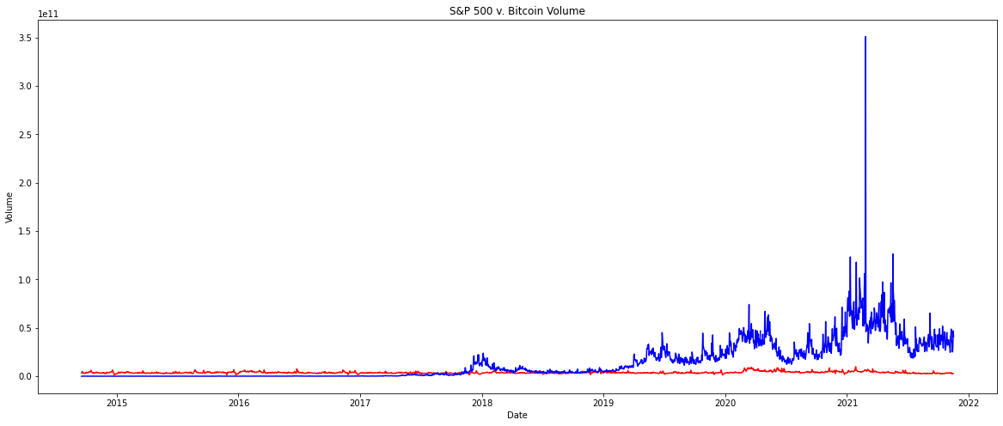
Notes:
Enis

Slide 12
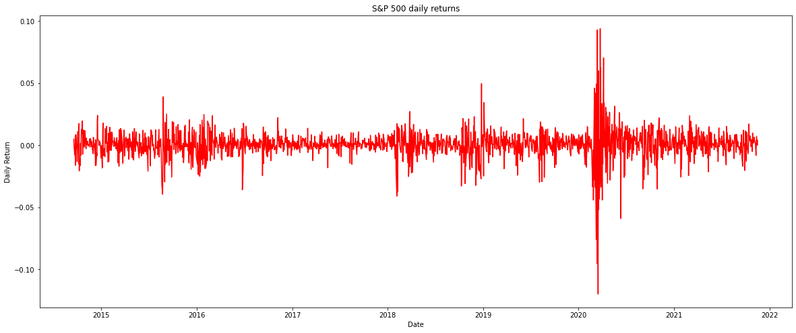
Notes:
Enis

Slide 13
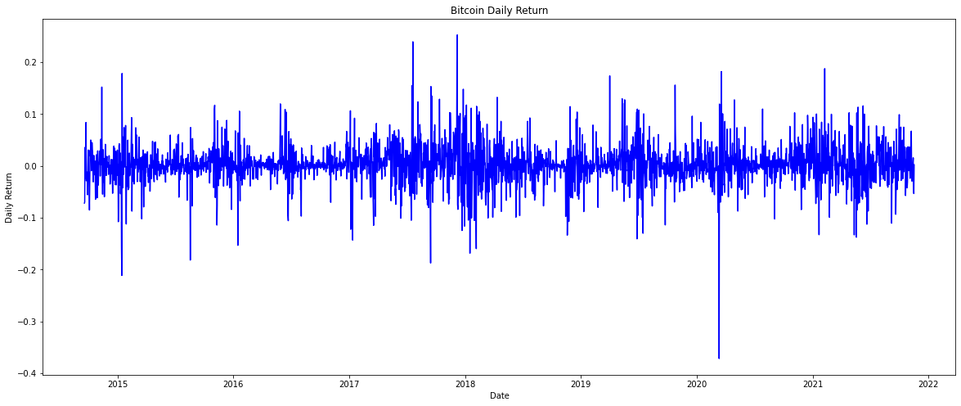

Slide 14
Sharpe Ratio
Ratio of mean daily returns and volatility.
Higher the better.
Sharpe ratio of Bitcoin: 1.290
Sharpe ratio of S&P 500 Index: 0.758

Slide 15
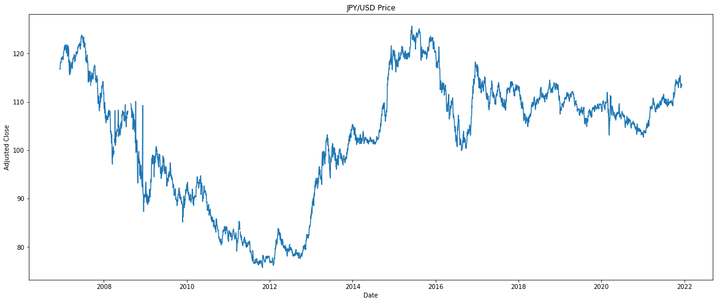

Slide 16
Technical Details and Implementation

Slide 17
Agent
Deep Q-Learning Model Using Keras
Sends buy and sell orders to the Environment
Receives a profit from the Environment after every sell order as a reward
Uses profit to learn how to trade better
Notes:
Pav

Slide 18
Environment
Daily Timeframe of JPY-USD, SPY, and AAPL
Receives buy and sell orders from the agent
Returns the reward to the agent when the agent sells its holdings of the security
Reward is the profit made
Notes:
Pav

Slide 19
Implementation
Q-Learning hyperparameters:
Gamma = 0.95
Gamma closer to 1 causes agent to consider future rewards over recent rewards
Epsilon = 1.0
Action Size = 3
Buy, Sell, Hold
4-Layer Neural Network
First 3 Layer Activation Functions are ReLu
Output Layer Activation Function is Linear
give real valued expected rewards to make buy, sell, or hold actions
Optimizer: Adam
Learning Rate: 0.001
Notes:
Pav

Slide 20
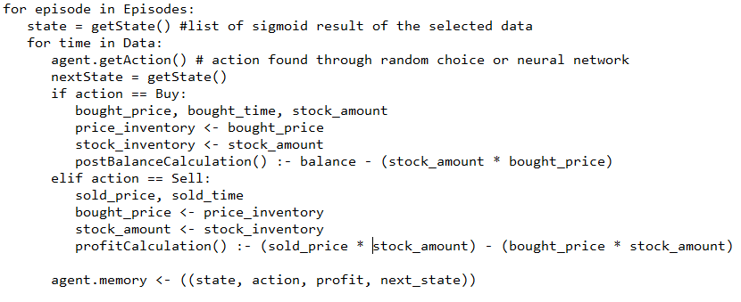
Implementation
Notes:
Pav

Slide 21
Results and Analysis

Slide 22
Results
JPY
SPY
AAPL
Notes:
Blue = sell
Red = buy

Slide 23
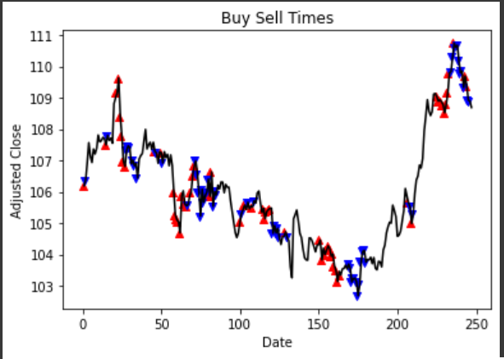
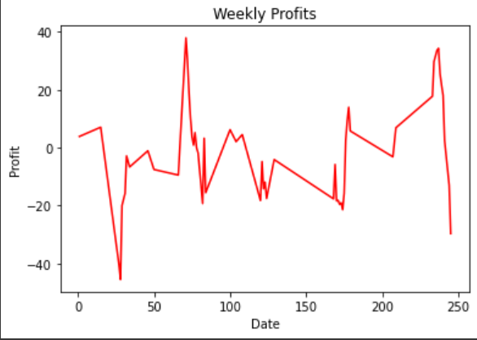
Notes:
Pav
JPY
One year
2 episodes and 30 window
2% return

Slide 24
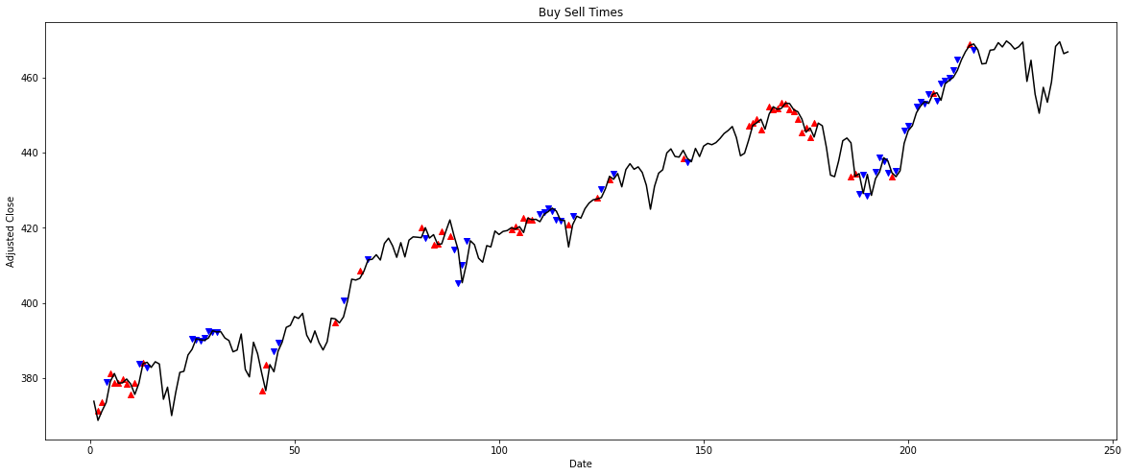
Results on the SPY Index
Notes:
Enis

Slide 25
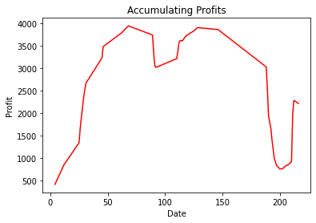
Notes:
Enis

Slide 26
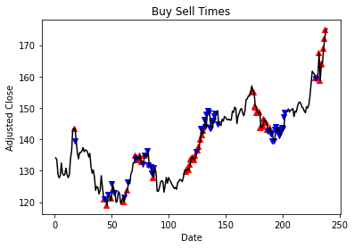
Notes:
Trevor
Window = 2 and episodes = 2
APPLE Stock
YTD
December 10 2020 - December 10 2021
Buys a lot during around 180 so it may be useful to look into what happened there for mitigation

Slide 27
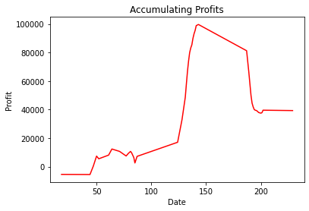
Apple Profits
Notes:
Trevor

Slide 28
Analysis
The model performs better than randomly chosen actions.
The model performs well when the equity price crashes by a significant amount because of the hold action.
2008 and 2020
No ML model is perfect, this model is no exception.
Notes:
Enis
Talking about similarity between 2008 and 2020 and how ML can help mitigate risk

Slide 29
Real World Application
If trading strategies do not return on average 8 – 12% a year, then investors should use passive strategies (investing in a low cost S&P 500 ETF)
Example: BUZZ vs SPY
SPY is up 27.16% YTD
BUZZ is 2.13% YTD

Slide 30
Next Steps

Slide 31
Next Steps
Feature engineering – selection and analysis
Compare against more RL methods and possibly some other ML methods
More testing – back and forward test using paper trading (Interactive Brokers / Alpaca)
Optimize code – maybe switch to Open AI Gym infrastructure
Notes:
Enis

Slide 32
Learning Outcomes and Retrospection
Don’t get caught up on testing hyperparameters – have a systematic approach
Collecting results for analysis takes up much of a ML project schedule – plan for it
Notes:
Trevor
Here we have some retrospection about our project and what we would do differently in the future.
It’s important to recognize what improvements can be made so we can plan accordingly for future projects
– It’s easy to get lost on obsessing over results

Slide 33
Questions?

